Slide 1
Capstone Engagement
Assessment, Analysis, and Hardening of a Vulnerable System

Slide 2
Table of Contents
This document contains the following sections:
01
Network Topology
02
Red Team: Security Assessment
03
Blue Team: Log Analysis and Attack Characterization
Hardening: Proposed Alarms and Mitigation Strategies
04

Slide 3
Network Topology
‹#›

Slide 4
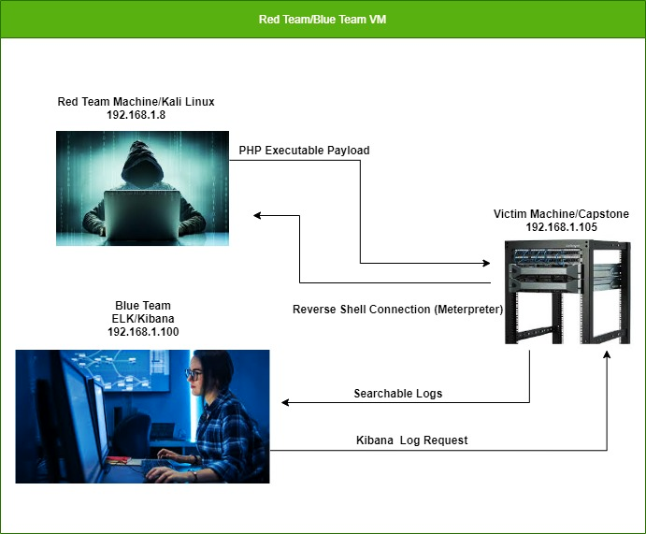
Network Topology
Network
Address Range: 192.168.1.0/24
Netmask: 255.255.255.0
Gateway: 192.168.1.1
Machines
IPv4: 192.168.1.105
OS: Ubuntu
Hostname: Capstone
IPv4: 192.168.1.100
OS: Ubuntu-headless
Hostname: Elk
IPv4: 192.168.1.8
OS: Kali Linux
Hostname: Kali
IPv4: 192.168.1.1
OS: Microsoft Windows
Hostname: Red vs Blue

Slide 5

Red Team
Security Assessment
‹#›

Slide 6
Recon: Describing the Target
Hostname | IP Address | Role on Network
Capstone | 192.168.1.105 | The Capstone Host is the victim machine that was exploited for the purposes of discovering vulnerabilities and insecure areas of the network it was hosted on.
ELK | 192.168.1.100 | The ELK Host aggregates logs from the Capstone server and analyzes the network traffic. The ingestion of filebeat, metricbeat, and packetbeat logs to Kibana allows for quick search functionality and visualization of suspicious activity.
Kali | 192.168.1.8 | Enterprise-ready security auditing Linux distro. Enables security professionals and IT administrators to conduct advanced penetration testing, forensic analysis, and security auditing.
Red vs Blue | 192.168.1.1 | The VM that the Capstone, Kali, and ELK machines are hosted on, serving as the gateway host to connect the machines together.
Notes:
Capstone Role: The Capstone Host is the victim machine that was exploited for the purposes of discovering vulnerabilities and insecure areas of the network it was hosted on.
Elk Role: The ELK Host aggregates logs from the Capstone server and analyzes the network traffic. The ingestion of filebeat, metricbeat, and packetbeat logs to Kibana allows for quick search functionality and visualization of suspicious activity. Through a functional understanding of log data, the analyst is able to make pragmatic discoveries and decisions about potential threats.
Kali Role: Kali Linux is an enterprise-ready security auditing Linux distribution based on Debian GNU/Linux. Kali is aimed at security professionals and IT administrators, enabling them to conduct advanced penetration testing, forensic analysis, and security auditing. Kali is the machine used to penetrate the capstone machine and collect valuable data that should have been otherwise un-discoverable.
Red Vs. Blue Host: The VM that the Capstone, Kali, and ELK machines are hosted on, serving as the Gateway Host (Network) to connect the Capstone, Kali, and ELK machines together.

Slide 7
Vulnerability Assessment
The assessment uncovered the following critical vulnerabilities in the target:
Vulnerability | Description | Impact
SSRF Vulnerability | SSRF allows interaction with the internal/external network or machine. | An SSRF vulnerability allows attackers to access sensitive information and perform unauthorized actions within the system.
Broken Authentication | Broken Authentication allows attackers to compromise passwords, keys, or session tokens. | This vulnerability allows attackers to assume the identity of other users to hijack sessions temporarily or permanently.
RCE Vulnerability | RCE allows the execution of code on a remote machine. | An RCE vulnerability allows access to a server as well as the ability to issue system commands.

Slide 8
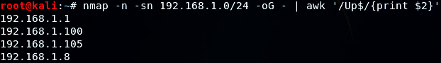
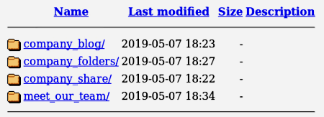
Exploitation: Server Side Request Forgery
Tools & Processes
Running a nmap scan against the IP range of the network returns a list of IPs that are currently online. With this information, the IPs can be inputted into a search engine to access the web server.
01
Achievements
This vulnerability allowed access to server IP Addresses. Once the IP address 192.168.1.105 was inputted into the browser, it returned the contents of the root directory.
02

Slide 9
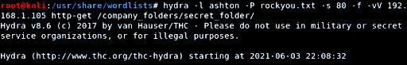
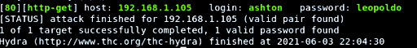
Exploitation: Broken Authentication
Tools & Processes
After finding the directory, a brute force attack, using hydra, was run against the webserver to gain the password for the secret folder.
01
Achievements
With running a hydra based brute force against the web server, using the user “ashton”, a password was returned that allowed access to the company’s secret folder.
02

Slide 10
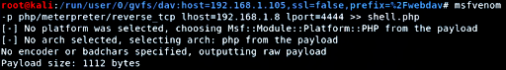
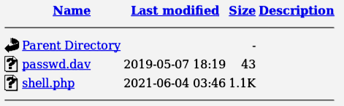
Exploitation: Remote Code Execution
Tools & Processes
Using msfvenom allows the injection of a reverse shell to the web server. This allows the local host IP to set up a connection over port 4444 to 192.168.1.105.
01
Achievements
Once the reverse shell has been clicked on and run, remote access is allowed within the machine. This allows directory transversal as well as access to otherwise confidential information.
02

Slide 11

Blue Team
Log Analysis and Attack Characterization
‹#›

Slide 12
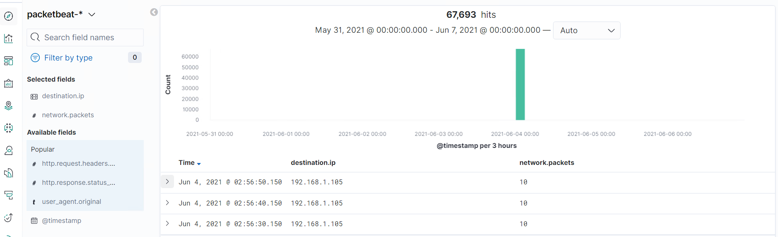

Analysis: Identifying the Port Scan
What time did the port scan occur? June 4, 2021 0030
How many packets were sent, and from which IP? 67,693 192.168.1.8
What indicates that this was a port scan?
Notes:
What time did the port scan occur? June 4, 2021 0030
How many packets were sent, and from which IP? 67,693 192.168.1.8
What indicates that this was a port scan? The large spike in packet traffic indicates the port scan is taking place

Slide 13
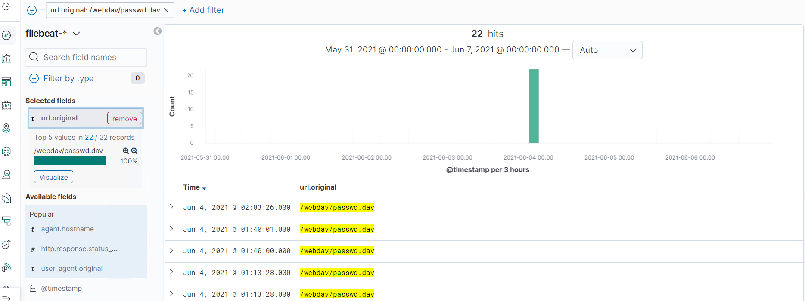
Analysis: Finding the Request for the Hidden Directory
What time did the request occur? June 4, 2021, 0108
How many requests were made? 22
Which files were requested? passwd.dav
What did they contain? Ryan’s hashed and salted password
Notes:
What time did the request occur? June 4, 2021, 0108 How many requests were made? 22
Which files were requested? passwd.dav What did they contain? Ryan’s hashed and salted password

Slide 14
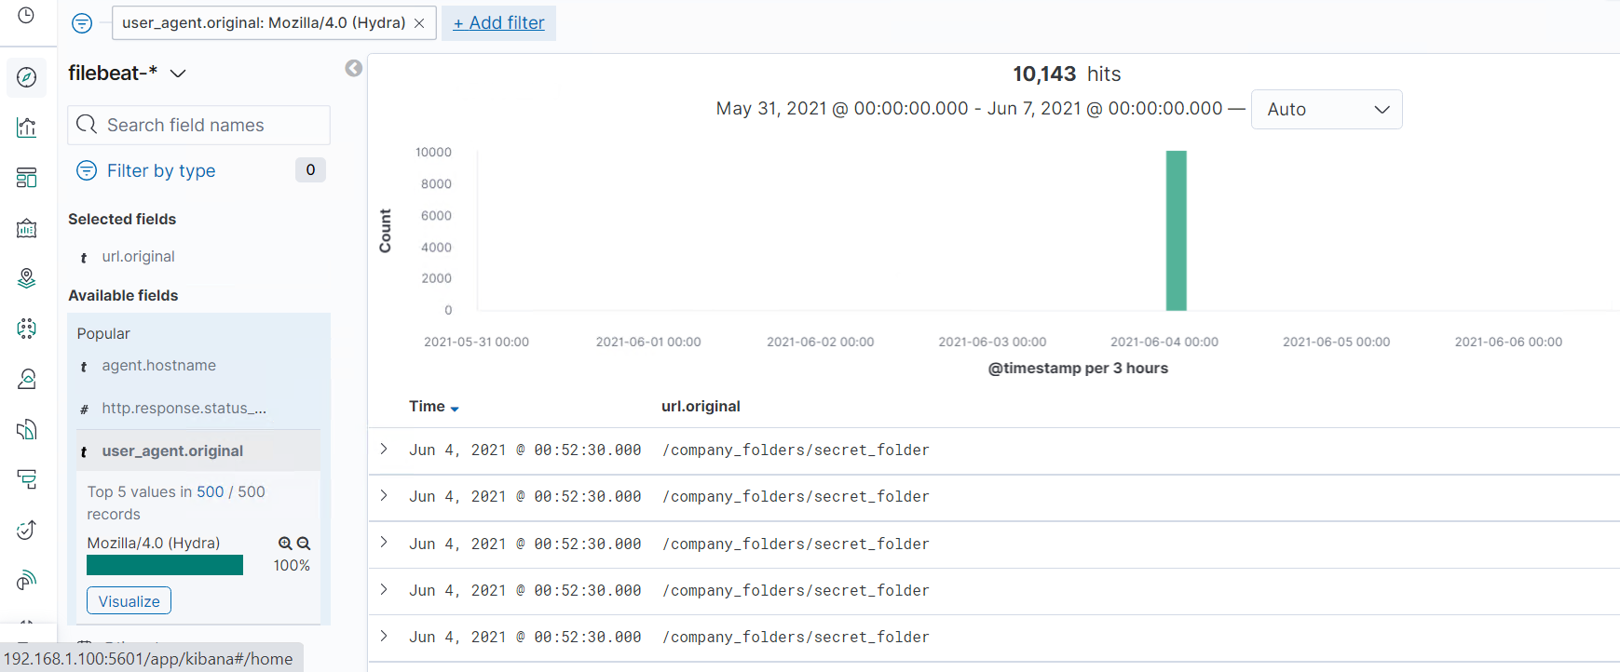
Analysis: Uncovering the Brute Force Attack
How many requests were made in the attack? 10,143
How many requests had been made before the attacker discovered the password? 10,143
Notes:
How many requests were made in the attack? 10,143
How many requests had been made before the attacker discovered the password? 10,143

Slide 15
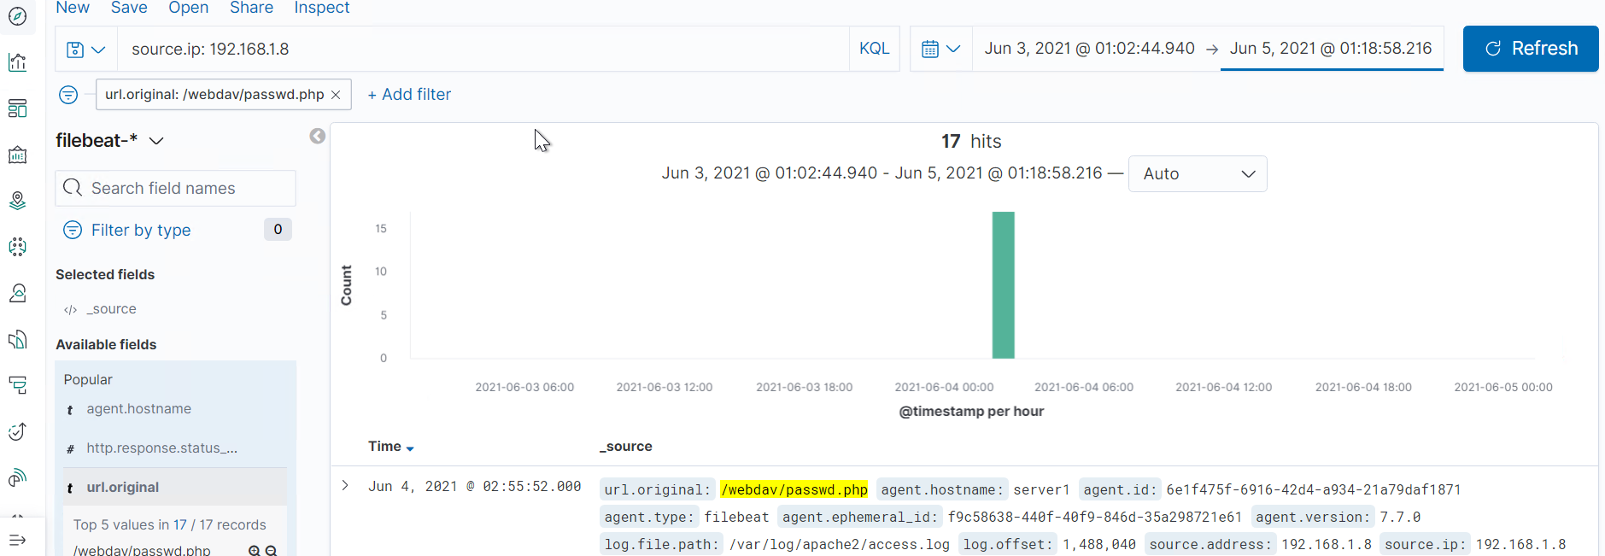
Analysis: Finding the WebDAV Connection
How many requests were made to this directory? 17
Which files were requested? passwd.php
Notes:
How many requests were made to this directory? 17
Which files were requested? passwd.php

Slide 16
Blue Team
Proposed Alarms and Mitigation Strategies
‹#›

Slide 17
Mitigation: Blocking the Port Scan
An alarm could be set to go off if a single source zone and/or ip address is communicating to a number of ports on the destination ip.
Could initially be set at 5-10 ports in any 3-5 minute window.
We could configure the firewall to respond with RST TCP packets. This is what happens when a TCP request is sent to a closed port. This will make accurate readings of the target almost impossible to obtain.
For example, in IPtables for Linux, you could do:
iptables -I INPUT -p tcp --dport <port> -j REJECT --reject-with tcp-reset

Slide 18
Mitigation: Finding the Request for the Hidden Directory
An alarm could be set to monitor access to the hidden directory. Considering only a handful of people should have access, anything over 10 requests could trigger the alarm.
To block unwanted access to this directory, you could harden the machine by allowing access only from within the network/IP pool. This way, no outside ip address would be given an opportunity to even attempt access.

Slide 19
Mitigation: Preventing Brute Force Attacks
You could set an alarm to go off if a certain number of login attempts are done within a restricted window of time.
In this case, we had over 10,000 login attempts within a 5 minute window. A threshold may be something like 100 attempts in a 5 minute window.
There are a few things we could do to harden the host machine. We could institute an account lockout feature, but there are a multitude of downsides to that, such as DoS attacks via intentionally locking out accounts, and harvesting valid usernames from error messages.
Simple measures like complex password requirements mitigate the chance of a successful brute force attack. A CAPTCHA can also be used to prevent automated brute force attempts.

Slide 20
Mitigation: Detecting the WebDAV Connection
An alarm could be created to trigger when someone from outside the network and/or predetermined ip pool attempts to access the WebDAV directory.
If the alarm is set to go off if it detects any access attempts from outside the network or ip pool, the threshold would be set to 1.
To harden the system, we could set an inbound firewall rule only allowing acceptected IP addresses to access the WebDAV directory.
The command for such a rule might look something like:
iptables -A INPUT -s 192.168.1.0/24 -j ACCEPT

Slide 21
Mitigation: Identifying Reverse Shell Uploads
To harden our system, we could employ multi-factor authentication to upload files and define valid types of files that the users should be allowed to upload. We could also use default-deny, so only specific IP addresses and ranges can make outbound connections, and we can control the services they are allowed to use. Authentication should be required to upload files. Examine each piece of code that can be used to upload files to make sure that the move_uploaded_files() function will not be executed unless the script is accessed by a valid authenticated user.
Set an alarm to detect any files that are uploaded, or any outbound connections made, from/to outside the network submask.
The threshold for this alarm will be set for 1 or more daily events.

